Slide 1
High Performance Android Java Application Development
Paul Hohensee
paul.h.hohensee@intel.com
August 4th, 2016
Notes:
0,0:40
Hi. I’m Paul Hohensee and I’ve been Intel’s Android Java runtime architect for the last couple of years. I’ve worked in and around managed runtimes and binary translation for a bit more than 20 years now, though mostly on the server side. I was at Sun and Oracle for 13 of those and ended up as the Hotspot JVM technical lead for 4 of them.
Today I’m going to talk about how to write Java code for Android that will get good results from the Android Runtime. Ideally, this talk shouldn’t be necessary, because the runtime should just transparently know what to do, but no runtime is perfect. ☺
I’m also going to talk about what ART is, Intel’s ART strategy, and what Intel’s doing to improve ART. Other than Google, Intel’s been the largest contributor to AOSP.
This talk is just an introduction, so I’ll have a reference slide at then end with pointers to off-line reading. There’s time for Q&A at the end, but feel free to ask questions during the talk.

Slide 2
What is ART?
Android RunTime
Predecessor was Dalvik
Executes apks (which contain dex bytecode)
Translates dex to native instructions (x86, arm)
Manages memory via Garbage Collection
Notes:
40,3:40
First, a brief introduction to ART, the Android Java runtime. ART has been the default since Lollipop when it was introduced as a replacement for Dalvik.
ART executes Android Package files or apks. Actually that’s not quite accurate, since apks contain all the app-specific components, among which are Dalvik executable, or dex, files, which are what ART really executes. Dex files are platform independent executable files that contain dex bytecode. Dex bytecode can be directly executed by an interpreter or compiled to native code.
Compilation can happen dynamically at runtime or statically before or after the first app launch. Dynamic compilation is often called Just-In-Time, or JIT compilation, though strictly speaking a JIT compiler replaces an interpreter and compiles bytecode and executes the resulting native code as it encounters it during at runtime. What most people mean when they say “JIT” is a dynamic compiler that is front-ended by an interpreter. The interpreter gets first crack at the bytecode and generates a profile of some sort to identify hot code. Then, the JIT compiler compiles only hot code identified by the interpreter. So the word JIT is used to describe what’s really a Hotspot compiler that runs only once in awhile.
Dalvik, which was the Java execution engine before ART, used a combination of an interpreter and a tracing JIT. Instead of having the JIT compile all the code as the program was being executed, it compiled only hot code paths or “traces” within a method. The theory was that that way only the hot parts of a method would be compiled, thus minimizing generated native code footprint. In practice, compiling an entire method at a time works just as well or better, so that’s what ART does. So the ART compiler is like a C++ compiler in that way.
Another compilation approach is called Ahead-Of-Time, or AOT. Some or all of the dex bytecode is compiled either before, during or after app installation time. Especially on embedded systems you often see an entire program compiled on the host so the native code is already part of the app at installation time. This is the totally static compilation approach that you see on iOS.
You can also compile at installation time, which is what ART has been doing in Lollipop and Marshmallow. The problem with that is that doing an optimized compiled can take awhile and AOT’ing an entire dex file makes for unacceptably long install times, to the point where a lot of people might abandon the entire app install. It can also lead to a big disk footprint for the generated code. Bad news.
Nougat relies on both a hotspot JIT and an AOT compiler. It doesn’t compile anything at install time and relies on an interpreter to generate profiles that a hotspot JIT compiler uses to generate optimized native code at runtime. This is the way that server Java implementations have been doing things since forever. ART in Nougat goes one step further than that though. It saves the profiles to disk and uses them to AOT compile the methods that had been JIT compiled. It does that only when the device is inactive and plugged in, so there’s no impact on user experience. And, only the hot methods are AOT compiled, so disk footprint is a lot smaller than before.
You can also compile some or all of the program completely off-device in the cloud after you’ve generated some profile info, which is basically the same as what a C++ compiler can do. No version of Android has done this yet though.
To make things more confusing, there have been two ART compilers. The first one was called the Quick compiler. It was fast, but didn’t do a particularly good job of optimizing generated native code, hence the name. It was the only ART compiler in Lollipop, but was replaced for applications by the Optimizing compiler in Marshmallow. In Marshmallow, the system libraries were still compiled with the Quick compiler, but in Nougat the Optimizing compiler is used for both system and app code. This talk is about helping the Optimizing compiler generate good code.
So, compilation is a complicated topic, but so is memory management. Java requires automatic memory management and that means continuously allocating and recycling memory. We call that process Garbage Collection, and it’s at least as complex as compilation. I’ll have a slide later about GC, but I’m not going to focus on it for this talk since in ART it can’t really be influenced by a programmer.

Slide 3
Agenda
What’s Intel’s approach to ART?
What’s Intel doing to improve ART?
What should developers do to get good performance from ART?
Notes:
4:20,0:10
So even though this is a talk about how to get good performance from ART, we need some background on Intel’s ART strategy and the things we’ve been doing to improve ART performance so you can know what to expect.

Slide 4
Agenda
What’s Intel’s approach to ART?
What’s Intel doing to improve ART?
What should developers do to get good performance from ART?
Notes:
4:30,0:05
First Intel’s ART strategy and what drives it.

Slide 5
What’s shaping Intel’s strategy?
Pure Android Java adoption is dropping, especially in PRC.*
48% of developers care about performance when selecting Android Target.**
38% of developers tune for CPU architecture.**
Java Goodness: Faster time-to-market, portability, better reliability, maintainability and extensibility, and ease of programming
*Intel App Market Data - Top 2000 Worldwide Apps WW48 2015
**Evan’s Mobile Development Survey 2015 Volume II
Notes:
4:35,0:50
We all know about managed runtime goodness compared to using native languages such as C++. These include better productivity and ease of coding, which lead to better reliability and maintainabililty. Programs written in managed languages such as Java are also more portable than native code as well as being extensible at runtime. All that means faster time to market, which is the holy grail for app developers.
But, none of it means anything if managed runtime performance isn’t good enough, and Android Java performance isn’t yet up to par as a percent of native compared to server Java performance. That means developers must drop into native code for the performance critical parts of their apps, which we at Intel see increasingly has been happening. That’s obviously not good for Intel compared to ARM, but it’s not good for developers either because being forced to use native code means the loss of Java goodness for the native part of your app.
What we ultimately want is for Java code to run at 80% or better of native code speed and that’s what Intel’s working on getting to.

Slide 6
Executing Java: Top 10 Real Apps Behavior
> 85% of bytecodes relate to object access, control transfer, loads and stores
Notes:
So, what does it mean to say “80% of native”? That depends on how you measure performance.
Until recently that’s been done using mostly unrealistic synthetic benchmarks such as CaffeineMark, Quadrant and CFBench which don’t reflect real user experience.
And here’s some data on what bytecodes real apps use. More than 85% of them relate to object access, method calls, branches, and loads and stores.
----
The integer math outlier is the java pdf viewer and the homescreen rotation scenario.
The floating math outlier is brower UX

Slide 7
Executing Java: Benchmark Behavior
Overemphasize math (int and float), Underemphasize objects, methods
< 45% of bytecodes relate to object access, control transfer, loads and stores
Notes:
And here’s a profile of the bytecodes that synthetic benchmarks use. The heavy yellow line is the mean of real app behavior on the previous slide.
Math is over emphasized, and less than 45% of the bytecodes relate to object access, method calls, branches, and loads and stores. Very different from real app behavior.

Slide 8
Android Java Performance Can Be Improved
Lots of headroom to improve Java performance where it matters
Notes:
5:25,0:50
To encourage realistic workload analysis, Intel’s built and open-sourced three new workloads based on what real apps do. One of them is the Java Application Component Workload for Android, which is a set of computational kernels from real apps. A comparison of OpenJDK8 verses Android Marshmallow ART shows that there’s lots of room for improvement, especially where it matters such as on html and pdf parsing. About the only place where ART is competitive with OpenJDK is on very simple kernels such as decimal and floating point math.
The code for this workload as well as for a GC workload called the Garbage Collection Workload for Android and a game-like workload called IcyRocks is on github under the android-workloads organization, so you can experiment for yourselves. The url is on the reference slide.

Slide 9
Intel ART Strategy
High performance Android Java platforms
Import server Java optimizations
Open source ecosystem
Portable Java applications
Less NDK/porting $$
More platform choices
Truly portable apps favor no particular Instruction Set Architecture (ISA)
Lower dev $$ & TTM
More Java goodness
Notes:
6:15,0:50
Here’s Intel’s ART strategy in a nutshell.
Mobile device capabilities are in many cases better than server device capabilities were 10 years ago, so optimizations that you might think of as appropriate only for server machines are in fact the right thing for current mobile devices. So, what we’re doing is importing server Java optimization ideas to ART and open sourcing everything we do. We’re open sourcing everything because improving Java performance only on Intel pretty much defeats portability and therefore Java adoption, so we’re hoping that ARM adoption will happen too. We’re pushing whatever Google accepts up to AOSP and will be open-sourcing the rest of our Marshmallow and Nougat work this month and next on github.
Portable and high performance Java apps mean less NDK and porting costs, which means less developer cost and shorter time-to-market. Truly portable apps favor no particular ISA, so developers get more platform choices. Of course this means that Intel has more of chance against ARM, but even ARM has a portability problem. Just think of what it costs to support both 32 and 64-bit versions of native ARM code, let alone libraries for combinations of several specialized ISAs.

Slide 10
ART (and Android) Device Scaling
Edge IoT
Auto
Wear
TV
Phones
Tablets
Chromebooks
Notes:
7:05,0:40
We’re also working at making ART scalable across the device range. One of the big advantages of a managed runtime over a non-managed one is the ability to adapt at runtime to the platform it’s running on. That means you can use versions of ART on everything from the IoT edge through every sort of mobile device up to a Chromebook. All you need is enough memory and cpu to run your app. You shouldn’t have to rewrite or optimize it for each platform.

Slide 11
Agenda
What’s Intel’s approach to ART?
What’s Intel doing to improve ART?
What should developers do to get good performance from ART?
Notes:
7:45,0:05
So, what’s Intel doing to improve ART?

Slide 12
Intel ART Performance Marshmallow 2015
IcyRocks opportunities lead to widening gaps with AOSP
Galaxy S6 Edge
ECS7 - Silver
Nexus 5X
Nexus 6P
ECS7 - Bronze
Gap with AOSP increases due to improvement in GCWfA
Karbonn Sparkle
*https://software.intel.com/en-us/android/articles/garbage-collection-workload-for-android
**https://software.intel.com/en-us/android/articles/icy-rocks-workload-a-real-workload-for-the-android-platform
Notes:
7:50,0:40
To pat ourselves on the back a bit, here’s what Intel accomplished for Marshmallow. This is a frequency normalized comparison over time between AOSP, which we call ART-Bronze, and Intel’s version, which we call ART-Silver. The measure of goodness is the geometric mean of CaffeineMark and Smartbench, which are a couple of standard benchmarks, Intel’s Garbage Collection Workload for Android and IcyRocks, and an Intel Compile Time workload. You can see we ended up about 30% better than plain vanilla AOSP in Marshmallow. We plan to be even better in Nougat.
I’ve got a backup slide with more recent Marshmallow data if we have some time at the end. We haven’t shipped it because there’s no more Marshmallow releases, but the optimizations will be in Nougat.

Slide 13
Intel ART Performance - How?
Icy Rocks Workload
Improved inlining.
Garbage Collection Workload for Android*
Improved thread state transitions. Compressing ROSs in place.
Caffeinemark, Smartbench
Loop Optimizations (Unrolling, Code Motion).
Compile Time
Inliner improvements, Heuristics tuning, footprint reduction.
Notes:
8:30,0:10
Here’s some of the optimizations we did to get those improvements. Basically, we improved the AOSP inliner and loop optimizer and reduced compiler memory and GC memory utilization.

Slide 14
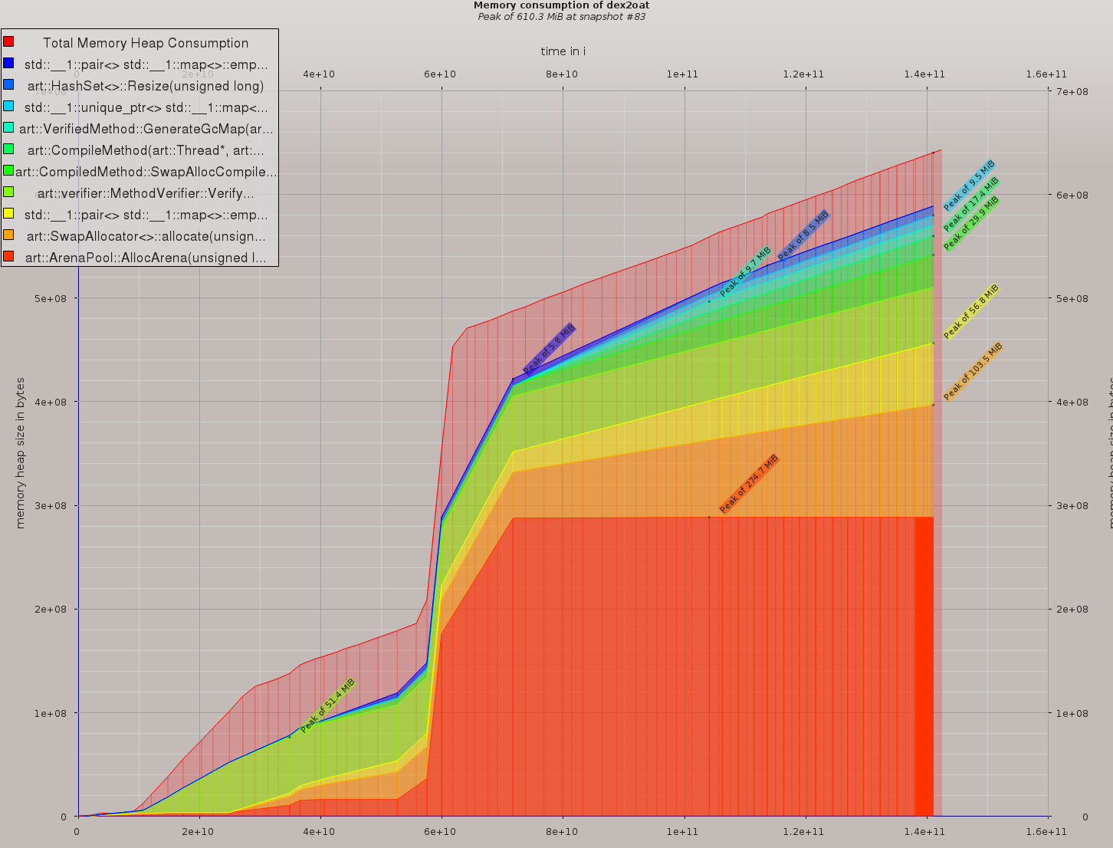
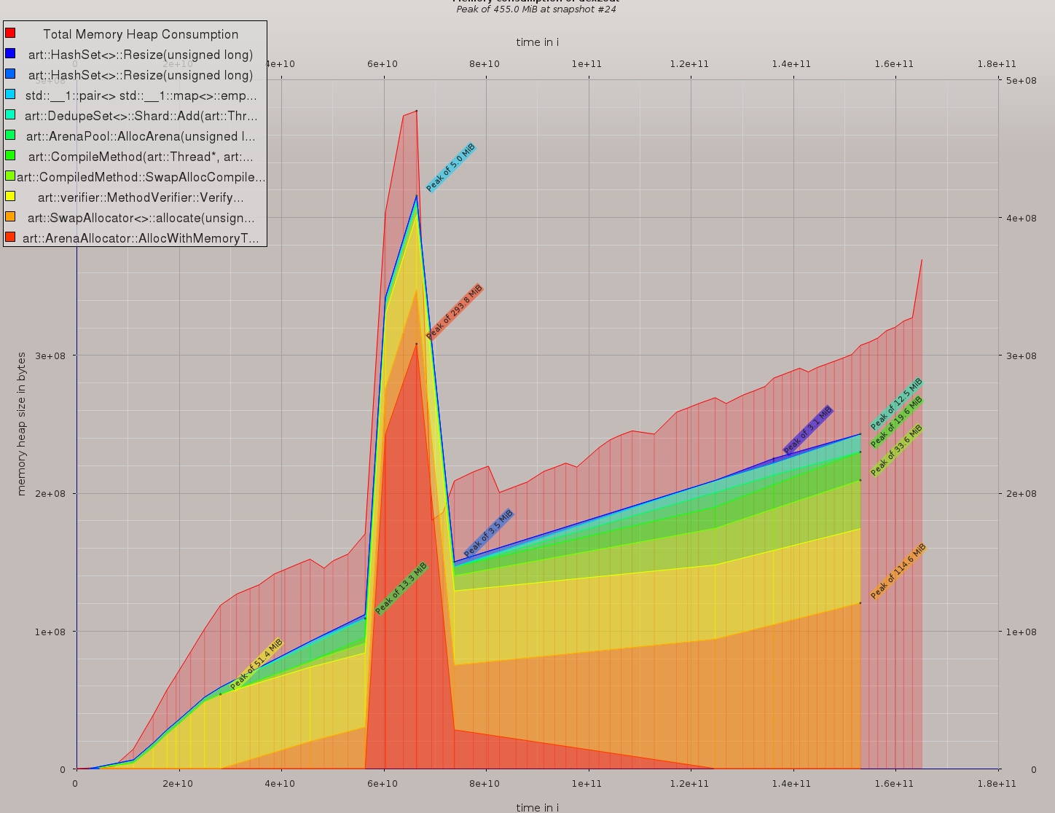
Memory Footprint: Before/After Compiler Optimizations
Before
After
Facebook compilation peak: 610MB
Facebook compilation peak: 455MB
Notes:
8:40,0:30
And here’s a pretty busy set of graphs of the ART Optimizing compiler memory use compiling Facebook, which is a truly large app which takes a long time to install on Marshmallow. Compiling it uses so much memory that it can hurt performance on whatever other apps you happen to be running. We managed to cut Optimizing compiler memory consumption by nearly a third in Marshmallow.

Slide 15
High Performance Java
Goal
Provide a reason to remain in Java code and not go to JNI
Means
Profiler
BB counts, virtual call counts
JIT profile persistence
AOT using the profiles for boot.oat (using discovery type system)
Call site specialization
Very useful for typical Java programs
Garbage collection
Generational collector
JNI Inlining
Notes:
9:10,1:50
We’re calling the result of the optimization work we’re doing High Performance Java. The goal is for developers to be able to stay in Java almost all the time and not have to go to JNI.
For the compiler, we’re going to generate and use more extensive profiling information than AOSP does, including information to allow us to generate a straight-line fast path through a method. We’re going to persist all the profile information for the AOT compiler and generate profiling info for AOT’ing the system libraries using a combination of training runs and interprocedural type analysis. We’re going to use those profiles to do call size specialization, which is the fundamental object-oriented language optimization. Call site optimization in Java and other OO languages is basically what is known as devirtualization. Devirtualization is replacing indirect virtual calls with direct calls to the target method, or inlining the target method’s code into the caller. To do that you have to figure out that a call site must always call the same method or guard a direct call or inlined code with a check to make sure the target method is what you expect. The goal is to either inline the target method or to have a virtual call reduce to passing the “this” object pointer and the method arguments directly to the target method.
For GC, we’re working on a new collector called the Generational Collector for Nougat. Preliminary performance results show Java heap footprint reductions of 60% and speedups on GCW in the 20% range with essentially no pause time increase.
We’re also working on inlining native code. That is, we’re eliminating JNI call overhead by parsing the native machine instructions, transforming them into compiler intermediate code and compiling the native code directly into the Java method. Not only can you get rid of the Java to native transition, which is typically upwards of 50 instructions, but you can also get rid of the upcalls from native to Java.

Slide 16
JNI Inliner
Improving UX by reducing latency of core framework functions
Latency spikes!
Notes:
11:00,0:20
Here’s some data from a JNI inliner prototype where we’ve inlined some OpenGL native methods. You can see that we’ve eliminated some latency spikes, which translates to perceptibly less Jank and higher FPS under load for workloads such as IcyRocks.

Slide 17
Generational Collector
Parallel Semi-Space Collector
(Background GC)
Concurrent CMS for Old Generation +
Semi-Space for Young Generation
Parallel young collection
STW pause: 2-3 ms typical
Art
TLAB object allocation, no lock, very fast, good locality
STW pause: almost never happens
Initial Mark by app threads
Parallel-concurrent mark
Parallel remark
STW pause: 2-3 ms typical
Parallel-concurrent sweep
Notes:
11:20,1:10
Here’s a picture of how GC works using the Generational Collector. Time flows down. Purple arrows are app threads and red arrows are GC threads.
On the left is the GC process for the background stop-the-world semi-space compacting collector, the one that runs on a foreground to background transition, and on the right the generational collector. Our goal is to eliminate the background collector unless absolutely needed. Stop the world, or STW, is a bad thing because it stops all app threads and induces Jank and other app delays.
The generational collector divides the Java heap into two spaces called the young and old generations. Almost all objects are allocated in the young generation and are only copied to the old generation if they live long enough to be worth it. Most objects “die young” and are never copied to the old gen. The young gen acts as a sort of filter, which is where the heap footprint reduction comes from. The old and young generations can be collected independently. There are a lot of short young collections, but relatively few old collections since allocation pressure on the old gen is greatly reduced.
We made the generational collector by using the existing Concurrent Mark Sweep collector for the old gen and the existing Semi-space collector for the young gen. We also parallelized as much as we could in order to take maximum advantage of multi-core processors. I could go on about GC for awhile and have a few backup slides if we have time and there’s interest.

Slide 18
Agenda
What’s Intel’s approach to ART?
What’s Intel doing to improve ART?
What should developers do to get good performance from ART?
Notes:
12:30,0:15
With the background out of the way, on to the code! I’ve got 10 tips. All of them were run on an Intel host, so the improvements aren’t exactly what you’d see on a mobile device, but since mobile devices are almost always less capable than host machines, the numbers are actually worst case.

Slide 19
Tip 1 - Use final keyword
Fields
final int field = 42;
Methods
final void GetField();
Classes
final class FieldHolder
Notes:
12:45,1:30
Tip number one. Use the “final” keyword wherever you can. You can apply it to fields, methods and entire classes.
When you tag a field as final you’re telling the compiler that if it’s a primitive type that its value is constant after the object it’s in has been constructed, which means that the compiler can replace a reference to a final field by its value. So the compiler can use “42” directly in the example, or replace the use of “field” with “42” in an arithmetic expression. What’s not as obvious is that if you use “field” as the size of any array, the compiler will know that and may be able to eliminate array index bound checks.
If a final field is of an object type and the compiler can figure out that it’s non-null, it can eliminate null pointer checks. Whether it’s null or not, the compiler may be able to delete code that depends on it being one or the other. For a String, since Strings are immutable and final, the compiler can treat its value like a primitive constant.
Now some of you will correctly note that even final fields can be changed via reflection, but it turns out that the Java language rules allow a compiler to ignore that possibility. It’s a very bad idea to do that anyway.
When you tag a method as final, you’re telling the compiler that the tagged method can’t be overridden in any subclass. That means that if the compiler can figure out what’s called the precise type of the target method, it can unconditionally devirtualize a call to it. That is, it can unconditionally change a virtual call to a direct call and/or inline it at will.
Finally, when you tag a class as final, you’re telling the compiler that there can’t be any subclasses of it. Effectively, you make all the class’s methods final.

Slide 20
Test Harness
public static void main(String[] args) {
long startTime = System.nanoTime();
test.Worker();
long endTime = System.nanoTime();
long durationUs = (endTime - startTime) / 1000;
System.out.println("Execution time is " +
durationUs + " us.");
}
Notes:
14:15,0:10
Here’s a sketch of the test harness we used. It’s pretty simple, just bracketing a call to a Worker method between two calls to System.nanotime. You may be wondering why I’m showing you this, but there’s a reason a few slides further on.

Slide 21
Final Method
public int ComputeResult(int i) {
return i;
}
public int Worker() {
int sum = 0;
for (int i = 0; i < 10000000; i++) {
sum += ComputeResult(i);
}
return sum;
}
public final int ComputeResult(int i) { // ⬅
return i;
}
public int Worker() {
int sum = 0;
for (int i = 0; i < 10000000; i++) {
sum += ComputeResult(i);
}
return sum;
}
Notes:
14:25,0:20
So here’s an example of declaring a method final. The Worker method just computes the sum of the results of 10 million calls to ComputeResult. The final tag is the only difference between the two ComputeResult methods, but it has a dramatic performance effect.

Slide 22
Final Method Comparison
Notes:
14:45,0:10
In fact it cuts execution time by almost a factor of four. Now, why did that happen?

Slide 23
Why is performance better?
Precise Type
Inliner
No method call
Notes:
14:55,0:10
It happened because by declaring ComputeResult final, the compiler was able to figure out exactly what its type was and unconditionally inline it.

Slide 24
Optimization applied
public final int ComputeResult(int i) {
return i;
}
public int Worker() {
int sum = 0;
for (int i = 0; i < 10000000; i++) {
sum += ComputeResult(i);
}
return sum;
}
public final int ComputeResult(int i) {
return i;
}
public int Worker() {
int sum = 0;
for (int i = 0; i < 10000000; i++) {
sum += i; // ⬅
}
return sum;
}
Notes:
15:05,0:15
Here’s what the code generator ends up seeing. All the call overhead disappears. This is perhaps an extreme example, but shows the importance of call site specialization in an object oriented language such as Java.

Slide 25
Tip 2 - Mark methods private
public int ComputeResult(int i) {
return i;
}
public int Worker() {
int sum = 0;
for (int i = 0; i < 10000000; i++) {
sum += ComputeResult(i);
}
return sum;
}
private int ComputeResult(int i) { // ⬅
return i;
}
public int Worker() {
int sum = 0;
for (int i = 0; i < 10000000; i++) {
sum += ComputeResult(i);
}
return sum;
}
Same performance as marking it final!
Notes:
15:20,0:15
Tip two. You can get the same result marking a method private as you can by marking it final. If you’re calling a method in the same class as the caller, then marking it private means the compiler knows its type, just as if it had been declared final.

Slide 26
Inlining Criteria
Inliner Pass
Find all of the method calls.
Is call target known?
Yes if method cannot be overridden:
Inliner Pass
Integrate callee code into caller.
Class is final
Method is final
Yes if method is private.
Notes:
15:35,0:20
To summarize what the compiler’s inliner does, first it finds all the method calls (of course!), then it tries to figure out what the method target actually is. If it’s private or final then the call target is known and the compiler can unconditionally inline it.
Inlining not only eliminates call overhead, it can also enable other optimizations and further inlining, effectively giving us interprocedural optimization on the cheap.

Slide 27
Final Class
public class Test {
public int ComputeResult(int i) {
return i;
}
public int Worker() {
int sum = 0;
for (int i = 0; i < 10000000; i++) {
sum += ComputeResult(i);
}
return sum;
} }
public final class Test { // ⬅
public int ComputeResult(int i) {
return i;
}
public int Worker() {
int sum = 0;
for (int i = 0; i < 10000000; i++) {
sum += ComputeResult(i);
}
return sum;
} }
Notes:
15:55,0:10
So here we drop ComputeResult and Worker into a final class. Care to guess what the result will be?

Slide 28
Final Class Comparison
Yes - the execution time really is 0 ms! But why?
Notes:
16:05,0:10
Rather unexpectedly, the execution time goes to zero! Why?

Slide 29
Remember the test harness?
Since class is final, it is inlined all the way to the call site!
public static void main(String[] args) {
long startTime = System.nanoTime();
test.Worker();
long endTime = System.nanoTime();
long durationUs = (endTime - startTime) / 1000;
System.out.println("Execution time is " +
durationUs + " us.");
}
Notes:
16:15,0:15
Remember the test harness? It’s just a call to a Worker method, but first ComputeResult is inlined into Worker and then Worker is inlined into the test harness! That enables more optimization of the test harness.

Slide 30
The power of interprocedural optimization
Result is not used
Dead Code Elimination (+ Unused Loop Removal)
Nothing to compute
Notes:
16:30,0:20
Once inlining is done into the test harness, the compiler can see that value of the “sum” result isn’t used, which means that the entire loop can be removed, so there’s nothing to compute!
This example also shows the perils of using simplistic test harnesses. Always make sure compiling the test harness can’t be influenced by the code it calls!

Slide 31
Tip 3 - Avoid JNI if possible
JNI transitions have significant overhead.
Avoid back to back native calls.
Make sure that x86 binary is deployed.
Better app performance
Avoid calling small native methods.
Notes:
16:50,0:55
Tip number three. Avoid JNI if possible. Java-to-native and native-to-Java transitions have significant overhead that involves argument list transformation, thread state updates and often a memory fence, which means you have to wait for all memory operations to complete before you can continue from either kind of call. All of these are very expensive.
If you must use JNI, make sure you don’t call small native methods because the overhead is a much higher percentage of the total cost when the native method is small. Try to avoid back-to-back native calls, since that effectively makes your Java app a native app and drastically reduces the compiler’s optimization scope.
And because I’m from Intel, I naturally recommend that you make sure an x86 binary is in your apk as well as an ARM binary. ☺ Calling an ARM binary on x86 will work, but only through the intervention of Houdini, Intel’s dynamic binary translator. Lots more overhead for that!

Slide 32
Native Method
public int ComputeResult(int i) {
return i;
}
public int Worker() {
int sum = 0;
for (int i = 0; i < 10000000; i++) {
sum += ComputeResult(i);
}
return sum;
}
public native int ComputeResult(int i); // ⬅
public int Worker() {
int sum = 0;
for (int i = 0; i < 10000000; i++) {
sum += ComputeResult(i);
}
return sum;
}
JNIEXPORT jint JNICALL Java_DevirtTipNative_ComputeResult
(JNIEnv* env, jobject thiz, jint arg) {
return arg;
}
Notes:
16:50,0:30
Here’s an example of what it costs to use a native method. Here we’ve made ComputeResult native and implemented it in C. It’s reasonably complicated to write the boilerplate on the native side of things, plus you have to put all the native code in a separate shared library, which are other reasons to avoid JNI.

Slide 33
Native Method Comparison
13x worse
Notes:
17:20,0:30
Since ComputeResult is trivial, we’ve violated the rule of not using small native methods. Here we see that the result is 13x worse performance using the native version of ComputeResult. Moral of the story, stick to Java if at all possible!

Slide 34
Tip 4 - Use locals in loops with calls
public class Rider {
private Bicycle bike = new Bicycle();
public void Ride() {
int rideDistance = 10000000;
for (int i = 0; i < rideDistance; i++) {
this.bike.Pedal(this); // ⬅
}
}
}
public class Rider {
private Bicycle bike = new Bicycle();
public void Ride() {
int rideDistance = 10000000;
final Bicycle currentBike = this.bike;
for (int i = 0; i < rideDistance; i++) {
currentBike.Pedal(this);
}
}
}
Notes:
17:50,
Tip number four. Use locals in loops with calls. That is, hoist complex loop invariant expressions yourself.
Here we have a method Ride in a class Rider than spins the pedals of a Bicycle 10 million times. Pretty tiring, so we want it to be optimized. ☺
You might expect the reference to “this.bike” on the left to be hoisted from the loop because it’s loop-invariant, but it turns out that it can’t because the compiler has no idea what the Pedal method might do. So, you have to do it yourself. A more extreme version of this happens when you allocate an object in the loop where the object turns out to be effectively invariant. The compiler can’t hoist it because the object constructor can have unknown side effects.

Slide 35
Why not hoisted by compiler?
Currently ART compiles a method-at-a-time
No interprocedural analysis.
So, all calls appear opaque - compiler does not know what’s happening.
Mitigation:
By using final methods and classes, compiler can inline -> IPO for free.
Manually hoist out loop invariants if known to not change.
Notes:
In fact, generally speaking, because the compiler compiles each method independently, unless the target method is inlined the compiler doesn’t know what’s happening in the target method, so it must assume the worst. That’s why using final methods and classes is so effective. You get the effect of interprocedural analysis without paying for it. If you know that a loop-computed value is invariant then by all means hoist it yourself!

Slide 36
Alias Analysis for loops How to decide to hoist a field getter?
Are there any setters in the loop?
If setter, check base, type, and index. If any different, then cannot alias.
Any store aliases?
Cannot hoist the getter - it is not invariant.
Found any?
Search for setters including potential ones like method calls.
If call, check if pure. If not, may alias.
Otherwise, hoist getter.
Notes:
Here’s what the compiler has to go through in order to hoist a simple getter method, and why it doesn’t happen very often.
Basically, it has to check for potential setters, including potential ones in method calls. If it finds any, it has to determine whether any of those setters alias to the getter. If any alias, then the getter isn’t really invariant, so it can’t be hoisted.
Since the compiler doesn’t do interprocedural analysis, any method call in the loop which isn’t inlined could result in a store to the field. If we can see all the code in the loop via inlining, then in the case of an array element getter we also have to check to see if the array reference and index are invariant. If the inlined code in turn does calls, then those have to be inlined too to make sure there are no unknown side effects in *that* code.
And so on. Inlining is *really* important!

Slide 37
Conservative assumptions
public class Rider {
private Bicycle bike = new Bicycle();
public void Ride() {
int rideDistance = 10000000;
for (int i = 0; i < rideDistance; i++) {
this.bike.Pedal(this);
}
}
public void UpdateBicycle(Bicycle newBike) {
this.bike = newBike; // // ⬅
}
}
public class Bicycle {
void Pedal(Rider rider) {
rider.UpdateBicycle(new Bicycle()); // ⬅
}
}
Compiler cannot assume that this.bike is invariant - the code here shows how it might change!
Notes:
On the right, here’s an example of what the Pedal method might do that the compiler can’t see. In this case, it gives you a whole new Bicycle every time you spin the crank. Talk about planned obsolecense!

Slide 38
Tip 5 - Keep exceptions exceptional
public class ExceptionTest {
private int value = 1;
private int value2 = 3;
public int ComputeResult(ExceptionTest other) {
return other.value; // ⬅
}
public int Worker(ExceptionTest other) {
int sum = 0;
for (int i = 0; i < 1000; i++) {
try {
sum += ComputeResult(other);
} catch (NullPointerException e) { // ⬅
sum += value2;
}
}
return sum;
}
}
public class NoExceptionTest {
private int value = 1;
private int value2 = 3;
public int ComputeResult(NoExceptionTest other) {
if (other != null) { // ⬅
return other.value;
} else {
return value2;
}
}
public int Worker(NoExceptionTest other) {
int sum = 0;
for (int i = 0; i < 1000; i++) {
sum += ComputeResult(other); // ⬅
}
return sum;
}
}
Notes:
Tip five is to keep exceptions exceptional. Don’t use exceptions in place of normal control flow.
In this example, the admittedly contrived code on the left uses a try-catch block to avoid conditional flow in ComputeResult, on the theory that the formal argument “other” will rarely be null. But that’s only a theory, not a fact. Handling even a single exception involves high overhead, and a single null “other” argument to the Worker method will provoke a thousand of them! Better to do an explicit null check in ComputeResult, as is done on the right.

Slide 39
Exceptions Comparison
Took 5ns to execute compared to ~15200 ns for other one!
Notes:
Here’s the result, with unfortunately the NoException case on the left, even though the NoException code was on the right in the previous slide. Exceptions really do cost a lot!

Slide 40
Tip 6 - Use array.length
public class Game {
private static final int NUM_CHARS = 1000;
private Character[] characters =
new Character[NUM_CHARS];
public void Play() {
for (int i = 0;
i < NUM_CHARS; // ⬅
i++) {
characters[i].Update();
}
}
}
public class Game {
private static final int NUM_CHARS = 1000;
private Character[] characters =
new Character[NUM_CHARS];
public void Play() {
for (int i = 0;
i < characters.length; // ⬅
i++) {
characters[i].Update();
}
}
}
Notes:
Tip six is to use the array length method for a loop bound whenever possible.
The inefficient code on the left attempts to tell the compiler that the array bound is NUM_CHARS in the loop, while the better code on the right just says to iterate over whatever the number of characters in the array is.

Slide 41
Java Semantics
ArrayIndexOutOfBoundsException required as per JLS
Compiler inserts runtime checks.
When array creation not visible, must assume potentially out of bounds.
Using array.length proves to compiler never out of bounds.
For more on this tip, check out:
https://software.intel.com/en-us/articles/how-to-optimize-java-code-in-android-marshmallow
Notes:
The problem is that when array creation isn’t visible to the compiler, it must assume that an ArrayIndexOutOfBounds exception is possible, even if the loop bound is a constant.
In the example, the compiler can’t know for sure that the “characters” array will always contain the same value, since the Game class might be subclassed, or the “characters” array written as a side effect of another method call as was “this.bike” in tip five. If characters.length is the loop bound, however, the compiler knows that the array index operation can never provoke an exception, so it can eliminate the bound check.

Slide 42
Array.length Comparison
Notes:
The cost of the bound check turns out to not to be that significant, only about 6% percent in this case, but every little bit helps!

Slide 43
Tip 7 – Bound Check Elimination
int totalAge = 0, totalSalary = 0;
// Bad code
for (int i = 0; i < age.length; i++) {// ⬅
totalAge += age[i];
totalSalary += salary[i]; // OOB possible!
}
// Good code: multiple conditions, so bound
// checks can’t be eliminated!
for (int i = 0;
i < age.length && i < salary.length; // ⬅
i++) {
totalAge += age[i];
totalSalary += salary[i];
}
int totalAge = 0, totalSalary = 0;
// Better code
// Bound check eliminated
for (int i = 0; i < age.length; i++) {
totalAge += age[i];
}
// Bound check eliminated
for (int i = 0; i < salary.length; i++) {
totalSalary += salary[i];
}
Notes:
In tip seven we get a bit more realistic and see what variations on using the length method will buy us.
We’re summing up two arrays in this example, “age” and “salary”.
The nominally “Bad” code on the top left assumes that both the age and salary arrays have the same length. That may be true, but the compiler has no way to know that, so it must generate a check on the access to the “salary” array. It’s still able to remove the check for the access to the “age” array though.
Now, you might say that we can fix that by making the loop bound check test both age.length and salary.length. So, let’s write some “Good” code on the lower left and “Better” code on the right to test that hypothesis. The “Good” code loop bound check looks at both array lengths in a single loop, while the “Better” code on the right uses two separate loops because we know for sure that the compiler knows how to eliminate a bound check on a single array.

Slide 44
BCE Comparison
Notes:
And here’s the perhaps unexpected result.
The nominally Good code in the middle with the complex bound expression is actually the slowest, since the loop bound expression is complex and takes longer to execute. It turns out that the compiler can’t analyze it and so it generates runtime bound checks on both array accesses.
The nominally Better code on the right uses two loops, but even though doing so eliminates the bound check in the loops, it still incurs two loop overheads, making it only slightly faster than what we predicted would be the Good code.
The actual best performing code is the nominally Bad code on the left, because it has a simple loop bound check and because it eliminates one of the array bound checks. The extra loop overhead in the Better and Good cases outweighs the cost of the single array bound check in the Bad code.
The moral of the story: get real data! You may think you know what the compiler will do, but in fact we’re not yet to the point where we can expect the compiler to do the right thing all the time. Trying different approaches and testing them is the way to go.

Slide 45
Tip 8 – Avoid False Sharing
// Spawn four threads that each execute
// the following
public static int num_tasks = 10000000;
for (int i = 0; i < num_tasks; i++) {
thread_array_sum[myThreadIdx] += work(i); // ⬅
}
// Spawn four threads that each execute
// the following
public static int num_tasks = 10000000;
int tmp = 0; // ⬅
for (int i = 0; i < num_tasks; i++) {
tmp += work(i); // ⬅
}
thread_array_sum[myThreadIdx] = tmp;
Notes:
In tip eight we show how memory system effects can hurt multi-threaded performance.
In this example, we spawn four threads, each of which does 10 million items of work and sums the results into a result array element indexed by the thread id. On the left, we sum directly into the result array element, while on the right we sum into a temporary variable and write the temporary into the result array after the loop finishes. How many expect a performance difference and if you do, which one is faster?

Slide 46
False Sharing Comparison
Notes:
If you said the version on the right summing into a temporary is faster, you were correct!. It’s more than four time faster than the version on the left that sums directly into the result array element!
That’s because of a memory system phenomenon called “false sharing”. While each result array element isn’t shared with any other thread, the result array as a whole *is* shared. Since all modern cpus use per-core on-chip caches, every write to the result array is a write into one of those caches rather than a write directly into memory. Since the caches aren’t shared, each thread must get the entire result array into its private cache before it can write its own result array element. To do that, the core that did the previous write must flush the result array from its cache to memory, and the core that wants to do a write must read the result array from memory into its private cache. The result is known as “block bouncing” and it’s quite expensive.
Moral of the story: watch out for and minimize inter-thread communication, especially communication that happens by unintentionally sharing parts of otherwise unshared data structures.

Slide 47
Tip 9 - Use Standard Libraries
public final class math {
public static float abs(float f) {
return f < 0 ? –f : f; // ⬅
}
}
ucomiss f, [0]
jge 1f
xorps f, [0x80000000]
1:
public final class math {
public static float abs(float f) {
return java.lang.Math.abs(f); // ⬅
}
andps f, [0x7fffffff]
Notes:
Tip nine says to use standard libraries whenever possible, because the compiler knows what they do and can optimize code that calls their methods.
In this example, we compare writing our own floating point absolute value method on the left with using java lang Math abs on the right. There’s a bit of assembly underneath to give you an idea of what code the compiler might generate on x86. Don’t worry about the details, just notice that the code on the left contains three instructions and a conditional branch vs. the single instruction on the right.

Slide 48
Math Library Comparison
Notes:
And we see that using the library version of the abs method is about twice as fast as rolling our own.
This kind of optimization is called “intrisification” and is another major kind of call site specialization that a compiler can do. Think of it as inlining without actually having to see the target method code and without having to recognize particular optimizable source code patterns. If a library method has fixed and documented functionality then the compiler can rely on its properties. In this case, abs is a pure function without side effects, so the compiler can implement it in the most efficient way.

Slide 49
Tip 10 - Mark release apps as non-debuggable
Compiler disables optimizations for debuggable apps (biggest one is inlining).
Production apps should be marked non-debuggable. This ensures the most optimizations are enabled.
Notes:
And the last tip, which we at Intel discovered the hard way. Make sure you mark your release bits as non-debuggable!
The Optimizing compiler disables optimization for debuggable apps, including call site specialization and loop optimization. That’s making code debuggable disables any optimization that crosses a dex bytecode operation boundary, which is basically all of them.

Slide 50
Check out these articles!
5 Ways to Optimize Your Code for Android 5.0 Lollipop
https://software.intel.com/en-us/android/articles/5-ways-to-optimize-your-code-for-android-5.0-lollipop
How to Optimize Java* Code in Android* Marshmallow
https://software.intel.com/en-us/articles/how-to-optimize-java-code-in-android-marshmallow
Intel Optimizations in the Android* Compiler
https://software.intel.com/en-us/articles/intel-optimizations-in-the-android-compiler
Intel Optimizations in the Android* Marshmallow Compiler
https://software.intel.com/en-us/android/articles/intel-optimizations-in-the-android-marshmallow-compiler
Icy Rocks Workload: A Real Workload for the Android* Platform
https://software.intel.com/en-us/android/articles/icy-rocks-workload-a-real-workload-for-the-android-platform
Garbage Collection Workload for Android*
https://software.intel.com/en-us/android/articles/garbage-collection-workload-for-android
Android: Road to JIT/AOT Hybrid Compilation Based Application User Experience
https://software.intel.com/en-us/articles/android-the-road-to-jitaot-hybrid-compilation-based-application-user-experience
The Java* Application Component Workload for Android* : Real Java* Application Use Cases for Android*
https://software.intel.com/en-us/android/articles/the-java-app-component-workload-for-android-real-java-app-use-cases-for-android
Open-source workloads
https://github.com/android-workloads
Notes:
That was the last tip.
I promised you a reference list at the beginning of the talk and here it is. Most of the content of this talk and more is in the white papers and you can download and run the workloads we at Intel have built from github.

Slide 51
Closing Thoughts
This translates to better application performance. Same app runs better.
Developers can ensure their apps get optimized by writing code in a compiler-friendly way.
Intel is actively working on improving VM and compiler technology.
Notes:
To summarize, Intel is actively working on improving ART performance, which translates to better java app performance. But, until we can build a compiler that knows all and sees all, you as developers can help it out by coding in a compiler friendly way.

Slide 52
Q & A
Notes:
And that’s it! Hope you enjoyed the talk and learned a few things.
I’ve got a few extra slides if anyone’s interested and wants to hang around a bit. Two of them show why optimizing for your typical synthetic benchmark doesn’t result in real world app performance improvement, one is a more recent comparison between AOSP and Intel ART on the only mobile SoC Intel still ships, and two more let me talk about object allocation and garbage collection in a lot more depth than just the one earlier slide.

Slide 54
CHT: Intel x5-Z8500 “Cherry Trail” 2.24GHz 4C, Android 6.0, 2GB RAM
Pixel C: 1.9GHz 4C Tegra X1 ARM Cortex A53 + A576.0.1, 3GB RAM
Galaxy S6 Edge: 2.1+1.5GHz 8C Exynos 7420/Cortex A53+A57. Android 5.0.2, 3GB RAM
CHT (ART-silver)
Pixel C $499.00
Galaxy S6 $599
CHT (AOSP)
Device | App Compile Time Workload | Garbage Collection Workload - 4Thread | AnTuTu 5.6 | CaffeineMark-RR | IcyRocks | SmartBench | Geomean
ART-AOSP | 1,505 | 57,485 | 4,098 | 43,803 | 12,343 | 5,326 | 2,600
Nexus 6p (OOB) | 539 | 81,082 | 4,199 | 66,000 | 7,737 | 10,901 | 2,318
Galaxy S6 Edge (OOB) | 1,802 | 98,241 | 4,225 | 54,258 | 14,444 | 13,024 | 3,041
Pixel (OOB) | 1,593 | 49,606 | 4,206 | 70,765 | 15,299 | 10,018 | 3,370
ART-Silver | 1,503 | 43,277 | 4,459 | 66,377 | 13,621 | 14,861 | 3,573

Slide 55
Dalvik vs. ART GC Overview
Serial Collector (GC for alloc)
Concurrent GC (GC as needed)
Serial Collector (Background GC)
Concurrent GC (GC as needed)
Dalvik
Lock heap to allocate
ART
Thread-local ROS, no lock
(mostly)
STW pause: GC pauses app threads
Initial Mark STW pause
STW pause almost never happens
in ART
Initial Mark by app threads
Concurrent mark
Concurrent mark
Remark STW pause
Parallel remark (sometimes)
STW pause: 2-3 ms typical
Concurrent sweep
Concurrent sweep
Notes:
Here’s some detail:
The arrows are threads and time flows from top to bottom of the slide. “STW” means “stop the world”.
There are two collectors, the concurrent mark/sweep or CMS collector which runs most of the time,
and the single thread compacting collector that runs when an attempt to allocate a new object by CMS fails
or, in ART, when there’s a foreground to background transition.
CMS mostly runs at the same time as the app threads, while the serial collector stops all app threads while it works.
With CMS, objects never move, which might lead to fragmentation, so we’ll eventually need compaction to free up space for new objects.
Objects reference one another and are ultimately referenced by a set of roots, which are
object references that live in registers, the thread stack and class static fields.
The 4 phases of a CMS cycle are:
Initial Mark to find all the roots.
Concurrent mark to traverse the object graph to find all the live objects.
Remark to catch up with object graph changes made during concurrent mark
And Concurrent sweep, to make dead object memory available for allocation again
Things to note:
In Dalvik, there are two STW pauses, initial mark and remark, while in ART there’s only a remark pause.
In Dalvik, both initial mark and remark are single threaded, while in ART initial mark is done by the application threads
and remark is done in parallel by several GC threads, reducing the pause time.
In Dalvik, a CMS cycle starts when the heap starts getting full, while in ART it starts based on the allocation rate
Dalvik locks the entire heap to allocate an object, while in ART the run-of-slots allocator locks a single run of slots, or ROS
And we’ll see a ROS is on the next slide

Slide 56
Intel’s Planned Memory Management: TLAB Allocation
A, B and C objects allocated and used at the same time
A is 16 bytes, B is 20 bytes, C is 40 bytes
Per Thread
TLAB
4b frag
Object A
Per Thread
ROS 16
No frag
ROS 32
12b frag
ROS 48
8b frag
Object B
ROS 128
Object C
…
Object C
Object A
Object B
ROS 256
…
Shared
ROS 12KB
> ~4K Objects
Shared

